Slide 1




INFOGRAPHIC
PRESENTATION
Name- Adarsh Kumar
Roll no. - 21052808

Slide 2
What we provide today?
What assumptions we made?
Our analysis assumes a stable economic environment with moderate inflation and interest rates.
SIMPLE STASTICS
We assume that competitors' strategies, pricing, and market positioning will remain consistent over the analysis period.
ANALYTICAL APPROACH
Our analysis assumes that external factors such as natural disasters, geopolitical events, or pandemics will not significantly disrupt operations beyond what is accounted for in risk management strategies.
ADDS CREDIBILITY
IMPACTFULLNESS
For our case we assumed the sales parameter as the sole decider of revenue.

Slide 3

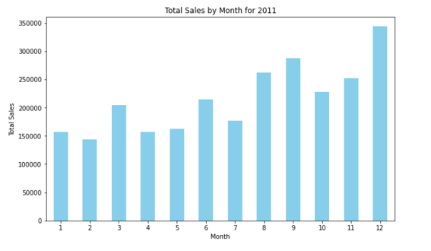
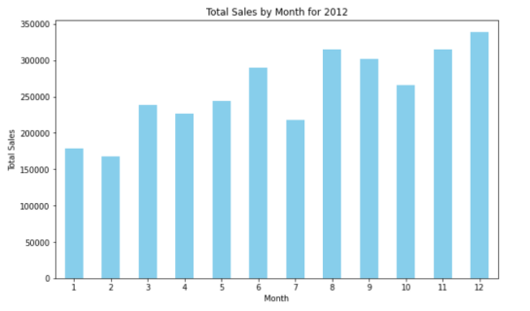
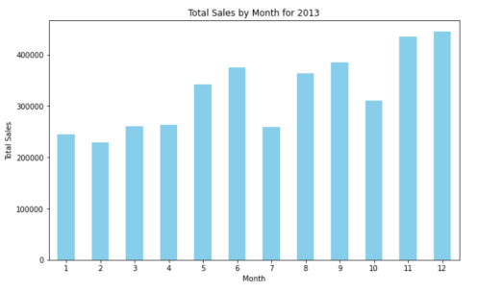
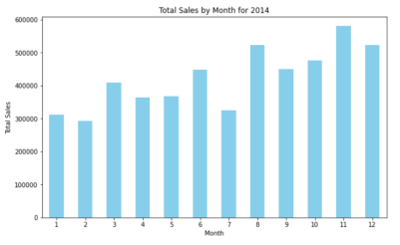
WE SAW A TREND!
Total monthly Sales
2011
2012
2013
2014
The sales trajectory demonstrates a consistent upward trend, but
A notable exponential surge is observed specifically in the final quarter.
The sales have grown exponentially during the years which forecasts consistent overall growth in the coming years.

Slide 4
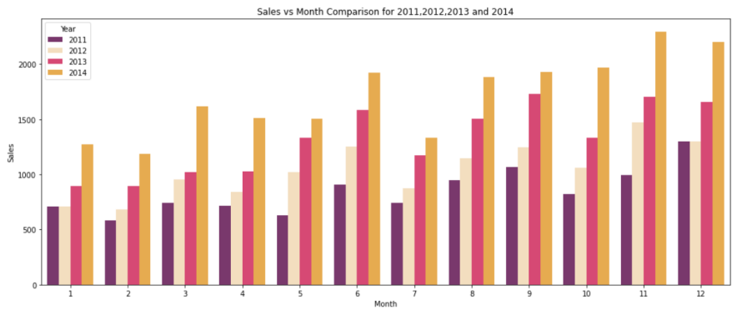
WHAT WE SUGGEST?
HAVE A LOOK INTO THIS
+24K
1ST QUARTER
STRONGLY
Implementing targeted marketing campaigns during first quarter of the year.
OVERALL
VERY STRONGLY
Optimizing product offerings overall.
LAST QUARTER
VERY VERY STRONGLY
Enhancing customer engagement through promotions, and leveraging data-driven strategies.

Slide 5
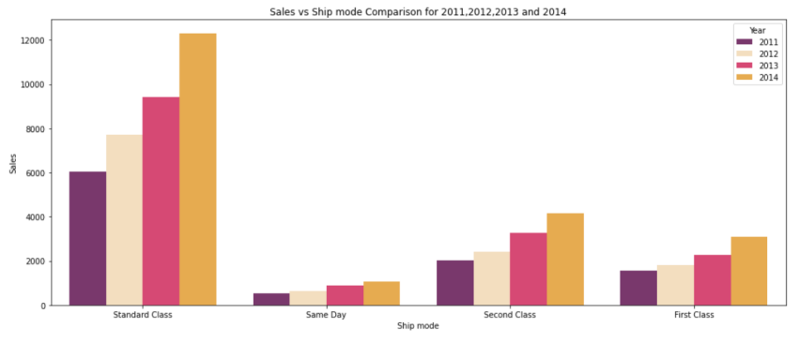
SHIP MODE AND SALES
STANDARD CLASS
SAME DAY
Continuously monitor and analyze customer feedback.
Invest in technology and infrastructure upgrades to enhance the overall shipping experience across all categories.
This category grows very less or we may say it doesn't grow.
But same- day delivery gives a very premium experience.
We can add a monthly subscription to this service for overall profit and to attract more customers.
SECOND CLASS
Optimize shipping routes and partner networks to reduce transit times and enhance efficiency.
Introduce cost-effective shipping bundles or loyalty programs to encourage repeat purchases.
FIRST CLASS
Enhance the delivery experience by providing tracking updates and estimated delivery times.

Slide 6

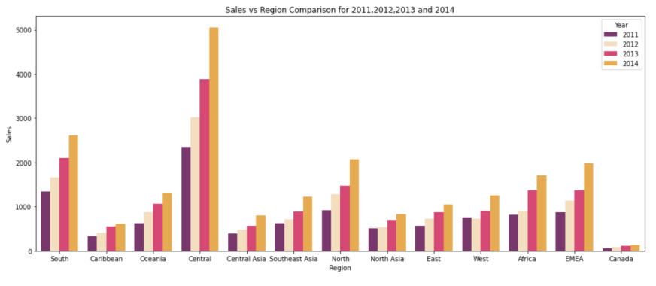
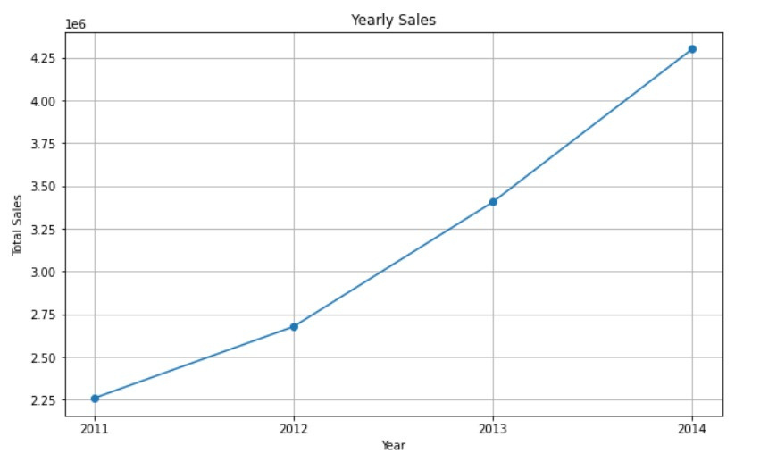
SUMMARY REPORT
Given that a significant portion of our revenue is generated from the central region, it is prominent to prioritize and allocate resources accordingly to capitalize on this profitable market segment.
For regions exhibiting lower revenue growth rate ,localized promotions, and enhanced customer engagement initiatives should be implemented to stimulate demand and drive sales growth in those regions.
The consistent growth rates observed in other factors over consecutive years, coupled with the presence of product-specific parameters, necessitate a thorough and detailed analysis to find underlying patterns and trends.
THANK YOU

